Slide 1
Network Fundamentals for Cloud
Nishit Narang
WILPD-CSIS

Slide 2
CC ZG503: Network Fundamentals for Cloud
Lecture No. 1

Slide 3
Introductions

Slide 4

Faculty Introduction – Dr Nishit Narang
Head and Associate Professor, Computer Science and Information Systems, Off Campus BITS Pilani (joined Dec 2020)
Academic Background:
B.Tech and PhD from IIT Delhi in Computer Science and Engineering
Expertise:
Computer & Communication Networks and Information Security
Past Experience:
Before BITS Pilani, worked for 23 years in the IT industry
Projects in terrestrial, satellite, and mobile communication networks, Industrial and Consumer IoT solutions involving industrial automation, smart city solutions, and consumer wearables
Over the years and across projects, focused extensively on Information Security and Cybersecurity.
Books Authored:
Co-author of four books in the communications domain, which are published by McGraw Hill and sold internationally

Slide 5
Course Introduction: Objectives
No | Description
CO1 | Understanding design and architectural choices for a data center network.
CO2 | Understand enabling technologies, protocols, tools and services used for implementation of cloud networks.
CO3 | Understanding cloud network performance and security challenges and methods to address them.

Slide 6
Course Structure Overview
Network Performance and Security
Virtual Cloud Networks
Network Topologies
TCP/IP Reference Model
Addressing Concepts
Routing and Switching Functions
VPNs and VLANs
Reliability in Data Transfer
Congestion Control, Flow Control and Traffic Engineering
Data Center Networks
(Physical Network)
Enabling Technology Overview
Network Fundamentals

Slide 7
Course Structure Overview
Network Performance and Security
Virtual Cloud Networks
Data Center Networks
(Physical Network)
Software Defined Networking
Network Function Virtualization
Enabling Technology Overview
Network Fundamentals

Slide 8
Course Structure Overview
Network Performance and Security
DCN Traffic Patterns and Challenges
DCN Architecture and Network Topologies
Routing Protocols for DCNs
Multi-DC Networks
SDN in the Data Center
Virtual Cloud Networks
Data Center Networks
(Physical Network)
Enabling Technology Overview
Network Fundamentals

Slide 9
Course Structure Overview
Network Performance and Security
Virtual Private Cloud
SR-IOV, vSwitch, OVS
Cloud DNS, Cloud NAT, Cloud VPNs
API Gateways, ALBs, CDN
Container Networking
Virtual Cloud Networks
Data Center Networks
(Physical Network)
Enabling Technology Overview
Network Fundamentals

Slide 10
Course Structure Overview
Cloud Network Security
Hypervisor Risks
Network Segmentation
Firewalls, Access Security Brokers, IPS
Traffic Monitoring & Visualization
Network Performance & Optimization
Network Performance and Security
Virtual Cloud Networks
Data Center Networks
(Physical Network)
Enabling Technology Overview
Network Fundamentals

Slide 11
Text & Reference Books
Text Book(s)
T1 | Kurose James F and Keith W. Ross: Computer Networking: A Top-Down Approach, Pearson India, 6th Edition, 2013
T2 | Lei Zhang, Le Chen. Cloud Data Center Network Architectures and Technologies, CRC Press 2021
T3 | Dinesh G. Dutt. Cloud Native Data Center Networking: Architecture, Protocols and Tools, O’Reilly 2020
R1 | Paul Goransson, Chuck Black. Software Defined Networks: A Comprehensive Approach, MK (Elsevier) 2014
R2 | Ken Gray, Thomas D. Nadeau. Network Function Virtualization, MK (Elsevier) 2016
R3 | Ronald L. Krutz, Russell Dean Vines. Cloud Security: A Comprehensive Guide to Secure Cloud Computing, John Wiley & Sons, 2010

Slide 12
Supporting Material
Other Reading Material
O1 | Jupiter Rising: A Decade of Clos Topologies and Centralized Control in Google’s Datacenter Network by Arjun Singh and Others
O2 | A Scalable, Commodity Data Center Network Architecture by Mohammad Al-Fares, Alexander Loukissas and Amin Vahdat
O3 | B4: Experience with a Globally-Deployed Software Defined WAN by Sushant Jain and Others
O4 | Cloud Service Provider (AWS, Azure, GCP) Public Domain Technical Documentation

Slide 13
Proposed Evaluation Scheme
No | Name | Type | Duration | Weight
EC-1 | Quiz-I | Online | - | 5%
EC-1 | Quiz-II | Online | - | 5%
EC-1 | Assignment-I | Online | - | 10%
EC-1 | Assignment-II | Online | - | 10%
EC-2 | Mid-Semester Test | Closed Book | 2 hours | 30%
EC-3 | Comprehensive Exam | Open Book | 3 hours | 40%

Slide 14
Fundamentals of Networking: Part 1
Slides Source: Computer Networking: A Top-Down Approach, 8th edition, Jim Kurose, Keith Ross, Pearson, 2020
All material copyright 1996-2020
J.F Kurose and K.W. Ross, All Rights Reserved

Slide 15
















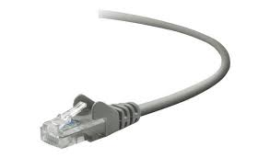
The Internet: a “nuts and bolts” view
Billions of connected computing devices:
  hosts = end systems
  running network apps at Internet’s “edge”
mobile network
national or global ISP
Packet switches: forward packets (chunks of data)
  routers, switches
local or regional ISP
Internet
Communication links
  fiber, copper, radio, satellite
  transmission rate: bandwidth
home network
content
provider
network
datacenter
network
Networks
  collection of devices, routers, links: managed by an organization
enterprise
network

Slide 16
The Internet: a “nuts and bolts” view
mobile network
4G
Internet: “network of networks”
  Interconnected ISPs
national or global ISP
protocols are everywhere
  control sending, receiving of messages
  e.g., HTTP (Web), streaming video, Skype, TCP, IP, WiFi, 4G, Ethernet
IP
Streaming
video
Skype
local or regional ISP
home network
content
provider
network
Internet standards
  RFC: Request for Comments
  IETF: Internet Engineering Task Force
HTTP
datacenter
network
Ethernet
TCP
enterprise
network
WiFi

Slide 17
What’s a protocol?
Human protocols:
“what’s the time?”
“I have a question”
introductions
Network protocols:
computers (devices) rather than humans
all communication activity in Internet governed by protocols
Rules for:
… specific messages sent
… specific actions taken when message received, or other events
Protocols define the format, order of messages sent and received among network entities, and actions taken on message transmission, receipt

Slide 18



What’s a protocol?
A human protocol and a computer network protocol:
Hi
TCP connection
request
Hi
TCP connection
response
Got the
time?
GET http://gaia.cs.umass.edu/kurose_ross
2:00
<file>
time
Notes:
Explain important points
distributed entities, exchanging messages (governed by protocols)
Time going down
go over definition of protocol (showing format, order of messages sent and received, and actions taken)
We’ll see these kinds of diagrams a lot

Slide 19
A closer look at Internet structure
mobile network
Network edge:
hosts: clients and servers
servers often in data centers
national or global ISP
local or regional ISP
home network
content
provider
network
datacenter
network
enterprise
network

Slide 20



Packet-switching: store-and-forward
L bits
per packet
source
3
2
1
destination
R bps
R bps
packet transmission delay: takes L/R seconds to transmit (push out) L-bit packet into link at R bps
store and forward: entire packet must arrive at router before it can be transmitted on next link
One-hop numerical example:
L = 10 Kbits
R = 100 Mbps
one-hop transmission delay = 0.1 msec

Slide 21

A closer look at Internet structure
mobile network
Network edge:
hosts: clients and servers
servers often in data centers
Access networks, physical media:
wired, wireless communication links
national or global ISP
local or regional ISP
home network
content
provider
network
datacenter
network
enterprise
network

Slide 22
A closer look at Internet structure
mobile network
Network edge:
hosts: clients and servers
servers often in data centers
Access networks, physical media:
wired, wireless communication links
Network core:
  interconnected routers
  network of networks
national or global ISP
local or regional ISP
home network
content
provider
network
datacenter
network
enterprise
network

Slide 23
Access networks and physical media
Q: How to connect end systems to edge router?
residential access nets
institutional access networks (school, company)
mobile access networks (WiFi, 4G/5G)
mobile network
national or global ISP
local or regional ISP
home network
content
provider
network
datacenter
network
enterprise
network

Slide 24










Access networks: enterprise networks
Enterprise link to
ISP (Internet)
institutional router
Ethernet
switch
institutional mail,
web servers
companies, universities, etc.
  mix of wired, wireless link technologies, connecting a mix of switches and routers (we’ll cover differences shortly)
    Ethernet: wired access at 100Mbps, 1Gbps, 10Gbps
    WiFi: wireless access points at 11, 54, 450 Mbps

Slide 25
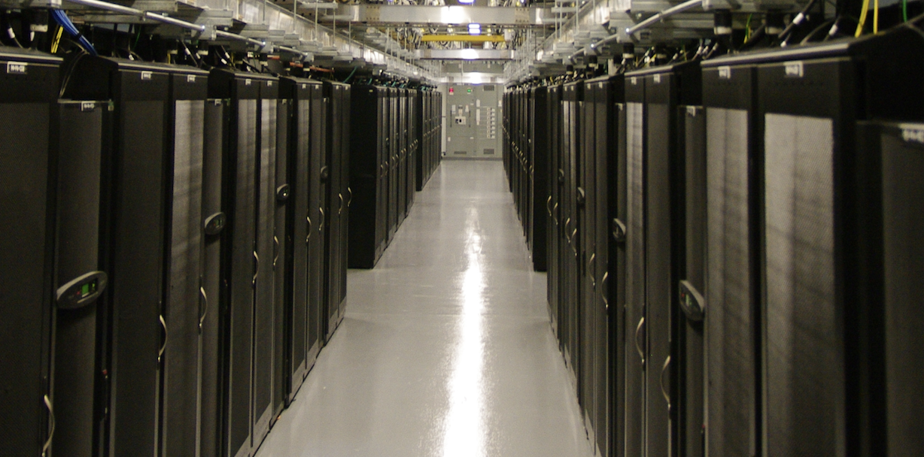
Access networks: data center networks
mobile network
high-bandwidth links (10s to 100s Gbps) connect hundreds to thousands of servers together, and to Internet
national or global ISP
local or regional ISP
home network
content
provider
network
datacenter
network
Courtesy: Massachusetts Green High Performance Computing Center (mghpcc.org)
enterprise
network

